Slide 1
Lecture Title
Course Code: 0052
Course Title: Computer Organization and Architecture
Dept. of Computer Science
Faculty of Science and Technology
Lecturer No: | 12 | Week No: | W12 | Semester: | Fall 24-25
Lecturer: | Noboranjan Dey; noboranjan@aiub.edu

Slide 2

Overview: SHIFT
Bits can be shifted left or right in a register or memory location.
When a bit is shifted out, it goes into CF.
Because a left shift doubles a number and a right shift halves it, these instructions give us a way to multiply and divide powers of 2.
Shifting is much faster than Multiplication and Division.

Slide 3
Overview: ROTATE
Rotates work like the shifts, except that when a bit Is shifted out one end of an operand it is put back in the other end.
These instructions can be used to examine and/or change bits or groups of bits.
*** Logic, shift, and rotate instructions is used to do binary and hexadecimal I/O.
The ability to read and write numbers will let us solve a great variety of problem.

Slide 4
SHIFT
Bits can be shifted left or right in a register or memory location.
When a bit is shifted out, it goes into CF.
Because a left shift doubles a number and a right shift halves it, these instructions give us a way to multiply and divide powers of 2.
Shifting is much faster than Multiplication and Division.

Slide 5
Shift Instructions
The shift and rotate instructions shift the bits in the destination operand by one or more positions either to the left or right.
For a shift instruction, the bits shifted out are lost
For a rotate instruction, bits shifted out from one end of the operand are put back into the other end.
The instruction have two possible formats. For a single shift or rotate, the form is
Opcode destination,1
For a shift or rotate of N positions, the form is
Opcode destination, CL
Where CL contains N In both cases, destination is an 8- or 16-bit register or memory location.
Shift or Rotate instructions can be used to multiply and divide by powers of 2, and we will use them in programs for binary and hex I/O
***Note that for Intel's more advanced processors, a shift or rotate instruction also allows the use of an 8-bit constant.

Slide 6
Left Shift (SHL) Instructions
The SHL (shift left) instruction shifts the bits in the destination to the left. The format for a single shift is
SHL destination, 1
A 0 is shifted into the rightmost bit position and the msb is shifted into CF. If the shift count N is different from 1, the instruction takes the form
SHL destination, CL (Here CL contains N and the above instruction made N single shifts)
The value of CL remains the same after the shift operation

Slide 7
Multiplication by Left Shift
Let us consider a decimal number 235.
If each digit is shifted left and 0 is attached on the right end, we get 2350 which is same as multiplying by 10.
Similarly, a left shift on a binary number multiplies it by 2.
For example, suppose that AL contains 5=00000101b
A left shift gives 00001010b = 10 thus doubling its value.
Another left shift yields 00010100= 20d, so it is doubled again

Slide 8
Shift Arithmetic Left (SAL)
SHL Instruction can be used to multiply an operand by multiples of 2.
However, to emphasize the arithmetic nature of the operation the opcode SAL (shift arithmetic left)often used in instances for numeric multiplication.
Both instructions generate the same ma chine code.
When we treat left shifts as multiplication, overflow may occur.
For a single left shift, CF and OF accurately indicate unsigned and signed over- flow, respectively.
However, the overflow flags are not reliable indicators for a multiple left shift as multiple shift is really a series of single shifts, and OF and CF only reflect the result of the last shift.

Slide 9
Right Shift (SHR) Instructions
The instruction SHR (shift right) performs right shifts on the destination operand
SHR destination, 1
A 0 is shifted Into the msb position, and the rightmost bit is shifted
SHR destination,CL
** here CL contains N In this case N single right shifts are made. The effect on the flags is the same as for SHL

Slide 10
SAR Instruction
The SAR Instruction (shift arithmetic right) operates like SHR , with one difference: the msb retains Its original value. The syntax is:
SAR destination,1
SAR destination, CL

Slide 11
Division by Right Shift
A Left shift doubles the destination's value,
Similarly, it’s reasonable to guess that a right shift might divide it by 2. This Is correct for even numbers.
For odd numbers, a right shift halves it and rounds down to the nearest integer.
For example, if BL contains 00000101 = 5, then after a right shift. BL will contain 00000010 = 2

Slide 12
Signed and Unsigned Division
In case of division by right shifts, we need to make a distinction between signed and unsigned numbers.
If an unsigned interpretation is being given, SHR should be used.
For a signed interpretation, SAR must be used, because it preserves the sign.

Slide 13
ROTATE
Rotates work like the shifts, except that when a bit Is shifted out one end of an operand it is put back in the other end.
These instructions can be used to examine and/or change bits or groups of bits.
*** Logic, shift, and rotate instructions is used to do binary and hexadecimal I/O.
The ability to read and write numbers will let us solve a great variety of problem.

Slide 14
Rotate Left (ROL)
The instruction ROL (rotate left) shifts bits to the left. The msb shifted into the rightmost bit.
The CF also gets the bit shifted out of the msb.
You can think of the destination bits forming a circle, with the least significant bit following the msb in the circle.
ROL destination, 1
and
ROL destination, CL

Slide 15
Rotate Right (ROR)
The instruction ROR (rotate right) works just like ROL except that the bits are rotated to the right.
The rightmost bit is shifted into the msb, and also into the CF
ROR destination, 1
ROR destination, CL

Slide 16
ROL, ROR and CF
In ROL and ROR, CF reflects the bit that is rotated out.
ROL and ROR can be used to inspect the bits in a byte or word, without changing the contents.
Example: Use ROL to count the number of 1 bits in BX, without changing BX. Put the answer in AX.

Slide 17
RCL (Rotate Carry Left)
The Instruction RCL (Rotate through Carry LEFT) shifts the bits of the destination to the left.
The msb is shifted Into the CF and the previous value of CF is shifted Into the rightmost bit.
In other words, RCL works like Just like ROL, except that CF is part of the circle of bits being rotated. The syntax is:
RCL destination,1
and
RCL destination, CL

Slide 18
RCR (Rotate Carry Right)
The Instruction RCR (Rotate through Carry RIGHT) works just like RCL except the bits are rotated to the right. The syntax is:
RCR destination,1
and
RCR destination, CL

Slide 19
Reversing Bit Pattern Application
Expectation: If AL contains 11011100, we want to make it 00111011
Use SHL to shift the bits out the left end of AL Into CF.
Then use RCR to move them Into the left end of another register (i.e. BL)
Run the above operation 8 times for 8 bits

Slide 20
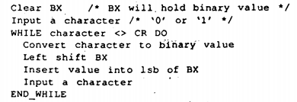
Binary and Hex Input & Output
Binary Input: Lets assume a program reads In a binary number from the keyboard, followed by a carriage return. [i.e. string of 0’s and 1’s]
Conversion in bit value needs to be done as soon as the input character is entered.
After that collect the bits in register.
To read a binary number from keyboard and store it in BX:

Slide 21
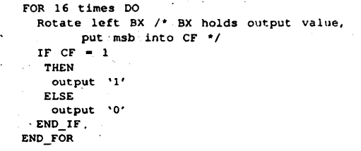
Binary Output
Outputting the contents of BX in binary also involves the shift operation.
Algorithm for Binary output:

Slide 22
Hex Input
Hex input consists of digits ("0" to "9") and letters ("A" to "F”) followed by a carriage return.
For simplicity, we will assume that
Only uppercase letters are used, and
The user inputs no more than four hex characters.
The process of converting characters to binary values is more Involved than it was for binary input, and BX must be shifted four times to make room for a hex value.

Slide 23
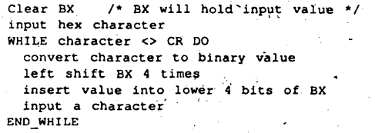
Algorithm for hex input

Slide 24
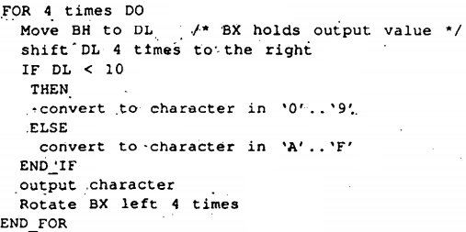
Algorithm for Hex Output

Slide 25
Task
Write an assembly language program for Binary Input and Output.
Write an assembly language program for Hex input and Output.
Write an assembly language program that binary number to hexadecimal number
Write an assembly language program that hexadecimal number to binary number.

Slide 26
References
Assembly Language Programming and Organization of the IBM PC, Ytha Yu and Charles Marut, McGraw Hill, 1992. (ISBN: 0-07-072692-2).
http://faculty.cs.niu.edu/~byrnes/csci360/notes/360shift.htm

Slide 27
Books
Assembly Language Programming and Organization of the IBM PC, Ytha Yu and Charles Marut, McGraw Hill, 1992. (ISBN: 0-07-072692-2).
Essentials of Computer Organization and Architecture, (Third Edition), Linda Null and Julia Lobur
W. Stallings, “Computer Organization and Architecture: Designing for performance”, 67h Edition, Prentice Hall of India, 2003, ISBN 81 – 203 – 2962 – 7
Computer Organization and Architecture by John P. Haynes.

